Slide 1
Openshift Container Platform
Workshop OCP Technical Overview
By : Oren Oichman
Title: Senior Solution Architect
Email : ooichman@redhat.com
IRC : two_oes/ooichman

Slide 2
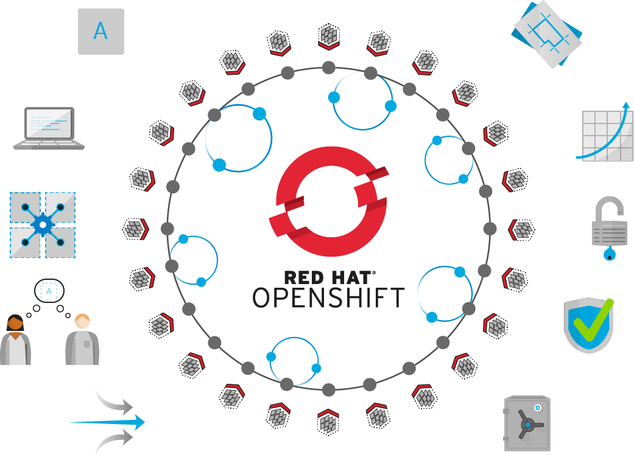
Self-Service
Standards-based
Multi-language
Web-scale
Automation
Open Source
Collaboration
Enterprise Grade
Multi-tenant
Secure

Slide 3
Openshift Architecture

Slide 4




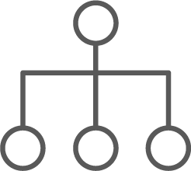
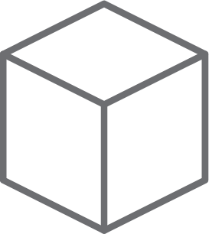

Architecture
Developers
Admins
Customer
CI/CD
CI/CD
EXISTING AUTOMATION TOOLSETS
API LOAD BALANCER
APP LOAD BALANCER
MASTER
WORKER
WORKER
OpenShift Services
Kibana | Elasticsearch
Application
Infrastructure
services
Registry
Application
Kubernetes
services
Router
Application
Prometheus | Grafana Alertmanager
Application
etcd
Monitoring | Logging | Tuned SDN | DNS | Kubelet
Monitoring | Logging | Tuned SDN | DNS | Kubelet
COMPUTE
NETWORK
STORAGE
Notes:
There are two types of hosts in an OpenShift environment. Workers are where user workload and various OpenShift components will land. Workers can be easily scaled and, on cloud providers, even scaled automatically based on cluster capacity.
The other type of host is the master. OpenShift uses 3 masters for high availability and cluster quorum. User workload does not run on the masters.
etcd is used to keep track of the state of everything in the cluster, from which users are logged in to where workload lives and more.
OpenShift is built on Kubernetes, and its core components are still there and directly accessible via Kubernetes’ APIs.
OpenShift brings its own web console with special features for both administrators and developers. OpenShift makes its features available through its own API endpoints which follow the same standard as other Kubernetes APIs using Custom Resource Definitions. OpenShift also brings a full lifecycle management solution that’s deeply integrated which allows for seamless and automatic cluster upgrades from within the cluster itself.
OpenShift includes a number of internal and support infrastructure services that make containers easier to use at scale.
And, because these services all run in pods as part of the platform, they can be orchestrated like any other workload and made to run across all hosts in the environment.
OpenShift also includes a log aggregation solution based on Fluentd, Elasticsearch, and Kibana. This integrated solution makes it easy to visualize and corroborate log events for applications that are scaled to many instances, and, it, too, is tied into OpenShift’s role-based access control (RBAC) ensuring that only the right people see the logs they are supposed to.
OpenShift extends Kubernetes ingress capabilities with an integrated router that bridges traffic from outside the cluster into the software defined network (SDN). This routing solution makes it easy for workload to be exposed and made accessible to consumers that are not inside the cluster.

Slide 5
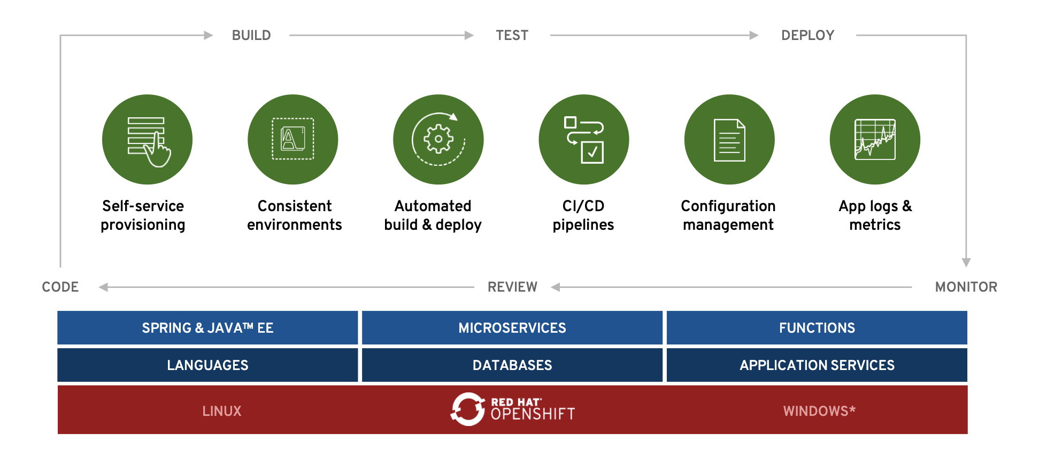
Openshift Development
*Coming soon

Slide 6

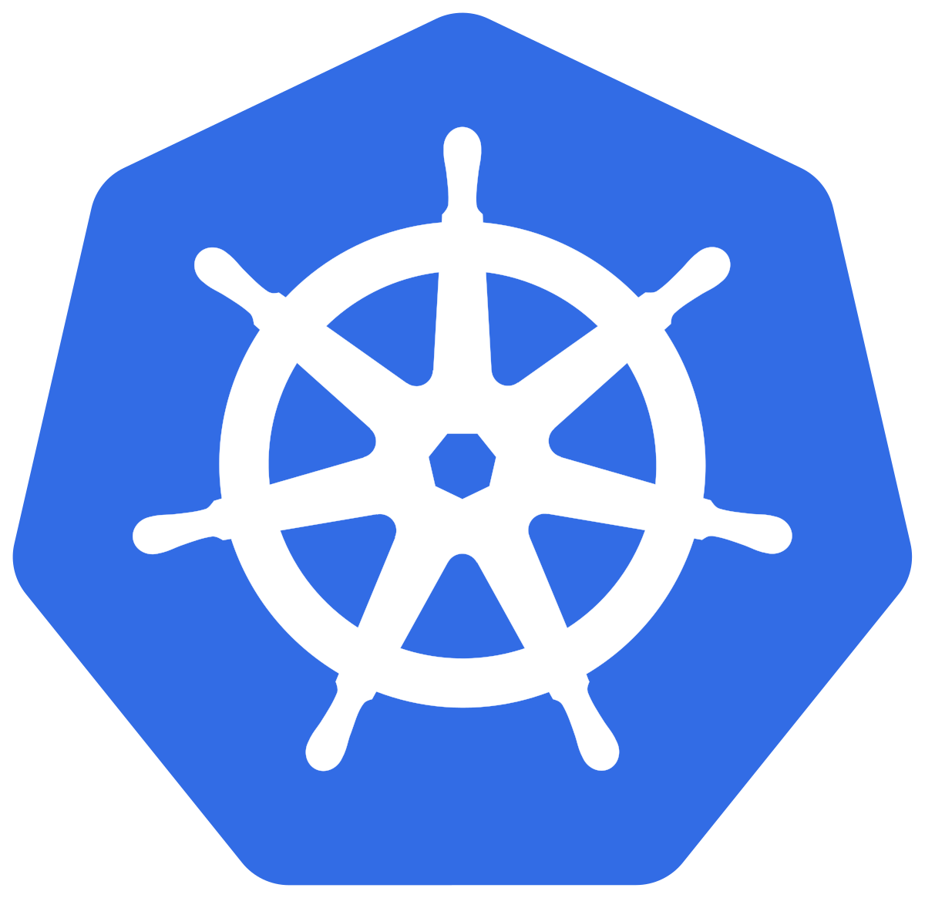
Architecture
Openshift Container engine
supports any OCI compatible runtime.
Kubernetes primary node agent
makes sure that containers are running in a Pod.
Kubelet
Source:
https://cri-o.io/
https://v1-17.docs.kubernetes.io/docs/reference/command-line-tools-reference/kubelet/
Notes:
A lightweight, OCI-compliant container runtime.
CRI-O is the best kubernetes specific container engine. Adoption is trivial since all existing Docker and OCI containers are supported and run great with CRI-O.
CRI-O is a light weight, kubernetes-native, OCI compatible container runtime that is life-cycled and managed by OpenShift. Customers no longer need to worry about which container runtime is in use - with OCP v4, it’s always the right one and it provide a complete implementation of the Kubernetes Container Runtime Interface, or CRI.
Also, gone are the days of separately managing the container engine. CRI-O is completely hands-free to run in production. The handful of tuneables that provide control and security for CRI-O are easy to configure via a CRD, and the settings will be propagated across the cluster.

Slide 7

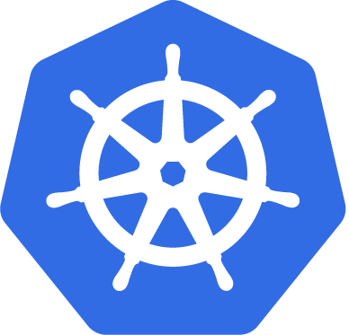
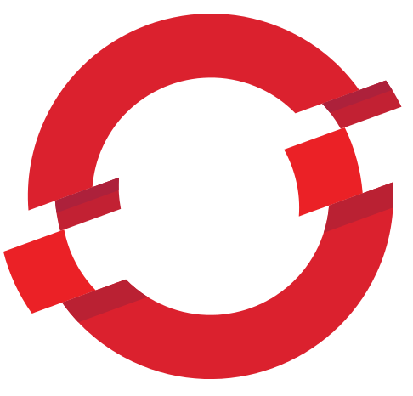
CRI-O Support in OpenShift
CRI-O tracks and versions identical to Kubernetes, simplifying support permutations
CRI-O 1.18
Kubernetes 1.18
OpenShift 4.5
CRI-O 1.19
Kubernetes 1.19
OpenShift 4.6
CRI-O 1.20
Kubernetes 1.20
OpenShift 4.7
Notes:
CRI-O is the best kubernetes specific container engine. Adoption is trivial since all existing Docker and OCI containers are supported and run great with CRI-O.
CRI-O is a light weight, kubernetes-native, OCI compatible container runtime that is life-cycled and managed by OpenShift. Customers no longer need to worry about which container runtime is in use - with OCP v4, it’s always the right one and it provide a complete implementation of the Kubernetes Container Runtime Interface, or CRI.
Also, gone are the days of separately managing the container engine. CRI-O is completely hands-free to run in production. The handful of tuneables that provide control and security for CRI-O are easy to configure via a CRD, and the settings will be propagated across the cluster.

Slide 8
Basic Concepts

Slide 9
Basic Concepts
Containers
A container is the smallest compute unit
Container

Slide 10
Basic Concepts
Containers
Containers are created from container images
Image
Container

Slide 11
Basic Concepts
Containers
Container images are stored in an image registry
Image Registry
Image
Container

Slide 12
Basic Concepts
Containers
an image repository contains all versions of an image in the image registry
Image Registry
Image
Container
myregistry/frontend
frontend:latest
frontend:2.0
frontend:1.1
frontend:1.0

Slide 13
The smallest compute unit that can be defined, deployed, and managed.
Basic Concepts
Pods
POD
Container
Container
10.140.4.44
Rough equivalent of a machine instance (physical or virtual) to a container.
apiVersion: v1
kind: Pod
metadata:
name: example
labels:
env: test
spec:
containers:
- name: containerone
image: example-image
- name: containertwo
Pods provide CPU, memory, network and storage to a container
Source:
https://docs.openshift.com/online/pro/architecture/core_concepts/pods_and_services.html
Notes:
Pods are the rough equivalent of a machine instance (physical or virtual) to a container. Each pod is allocated its own internal IP address, therefore owning its entire port space, and containers within pods can share their local storage and networking.

Slide 14
Allow you to decouple configuration artifacts from image content.
Basic Concepts
Configmaps
Dev
Prod
apiVersion: v1
kind: ConfigMap
metadata:
name: example
data:
MYCONFIG=true
POD
apiVersion: v1
kind: ConfigMap
metadata:
name: example
data:
MYCONFIG=false
POD
CONTAINER
CONTAINER
Source:
https://v1-17.docs.kubernetes.io/docs/concepts/configuration/secret/
https://kubernetes.io/docs/concepts/configuration/configmap/

Slide 15
Provide a mechanism to hold sensitive information such as passwords
Basic Concepts
Secrets
Dev
Prod
apiVersion: v1
kind: Secret
metadata:
name: mysecret
type: Opaque
data:
password: MWYyZDFlMmU2N2Rm
POD
apiVersion: v1
kind: Secret
metadata:
name: mysecret
type: Opaque
data:
password: cHJvZAo=
POD
CONTAINER
CONTAINER
Source:
https://v1-17.docs.kubernetes.io/docs/concepts/configuration/secret/
https://kubernetes.io/docs/concepts/configuration/configmap/

Slide 16
Each time a deployment is triggered, whether manually or automatically, a deployer Pod manages the deployment
Define how to roll out new versions of Pods
Basic Concepts
Deployments and DeploymentConfigurations
apiVersion: v1
kind: DeploymentConfig
metadata:
name: frontend
spec:
replicas: 5
selector:
name: frontend
...
v1
v2
POD
POD
CONTAINER
CONTAINER
Source:
https://docs.openshift.com/container-platform/4.4/applications/deployments/what-deployments-are.html

Slide 17
Ensures that all
(or some) nodes run a copy of a pod
Use cases:
Cluster storage daemon
Logs collection daemon (fluentd)
Node monitoring daemon (node-exporter)
Network daemon (dns, sdn,ovs)
Basic Concepts
Daemonset
✓
✓
apiVersion: apps/v1
kind: DaemonSet
metadata:
name: example
spec:
Selector:
matchLabels:
name: example
...
POD
POD
CONTAINER
CONTAINER
Node
Node
Node
foo = bar
foo = bar
foo = baz
Source:
https://docs.openshift.com/container-platform/4.4/applications/deployments/what-deployments-are.html

Slide 18
Manages the deployment and scaling of a set of Pods, and provides guarantees about the ordering and uniqueness of these Pods.
Used to manage stateful applications
Basic Concepts
Statefulset
apiVersion: apps/v1
kind: StatefulSet
metadata:
name: web
spec:
Selector:
matchLabels:
app: example
serviceName: "nginx"
replicas: 3
template:
metadata:
labels:
app: example
Spec: terminationGracePeriodSeconds: 10
Containers: ...
Source:
https://kubernetes.io/docs/concepts/workloads/controllers/daemonset/

Slide 19






A Liveness checks determines if the container in which it is scheduled is still running.
A Readiness check determines if the container in which it is scheduled is ready to service requests.
Basic Concepts
Liveness and Readiness
alive?
ready?
Source:
https://docs.openshift.com/container-platform/4.4/applications/application-health.html

Slide 20

A project allows a community of users to organize and manage their content in isolation from other communities.
Projects starting with openshift- and kube- host cluster components that run as Pods and other infrastructure components.
Basic Concepts
Projects
PAYMENT DEV
POD
POD
POD
C
C
C
PAYMENT PROD
POD
POD
POD
❌
C
C
C
Source:
https://docs.openshift.com/container-platform/4.4/applications/projects/working-with-projects.html

Slide 21

Networking
A dedicated Network Workshop will deal with networking details

Slide 22

Services provide internal load-balancing and service discovery across pods
Routes make services accessible to clients outside the environment via real-world urls
Networking
Openshift Networking
ROUTE
SERVICE
POD
POD
Container
Container
POD
POD

Slide 23

Networking
Openshift Networking
EXTERNAL TRAFFIC
ENDPOINT LOOKUP
INGRESS CONTROLLER
SERVICE
PROXIED CONNECTIONS
POD
POD
Container
Container
POD
POD

Slide 24


Networking
Openshift SDN
NETNS
NETNS
NETNS
NETNS
POD
10.1.4.2
POD
10.1.4.4
POD
10.1.4.2
POD
10.1.4.4
eth0
eth0
eth0
eth0
veth
veth
veth
veth
br0 Open vSwitch Bridge
br0 Open vSwitch Bridge
tun0
vxlan
tun0
vxlan
iptables
Physical Network
iptables
NODE 172.16.1.10
NODE 172.16.1.20
eth0
eth0

Slide 25


The History of Containers
Begin Exercise 3
Source:
Insert source data here
Insert source data here
Insert source data here

